Slide 1

Hotel Review Data Analysis
DS-P-281
BY GROUP: 2
G. Vijay
J. Manil
Pooja
Saloni

Slide 2
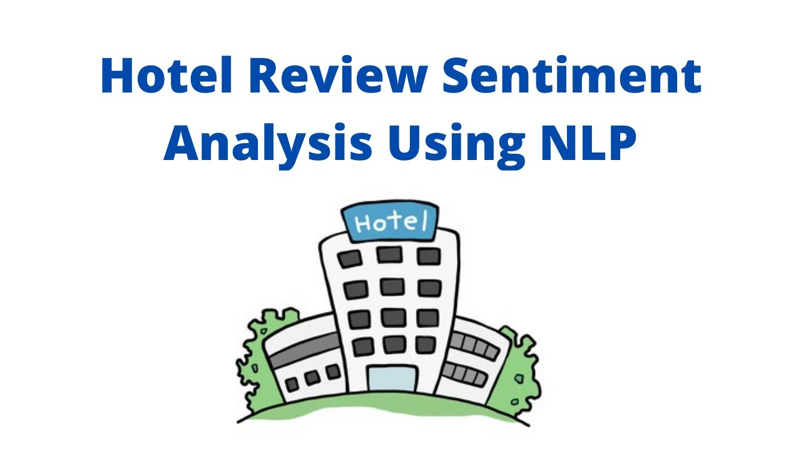
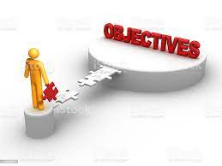
Objective:
Our goal is to examine how travellers are communicating their positive and negative experiences in online platforms for staying in a specific hotel and major objective is what are the attributes that travellers are considering while selecting a hotel. With this manager can understand which elements of their hotel influence more in forming a positive review or improves hotel brand image.

Slide 3
Project Flow
Data Input
Data Pre-processing
Exploratory Data Analysis
Training Various Models
Predicting Results and Selecting Best Model
Analysis and Conclusion
Deployment
RESULT

Slide 4
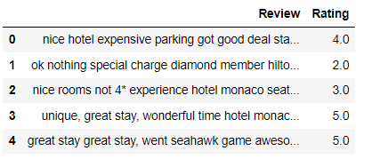
Data Summary
Dataset details:
The above dataset containing hotel reviews provided by client.
The Dataset contains 20,491 rows and 2 columns.
The Dataset does not have duplicate or missing values.

Slide 5
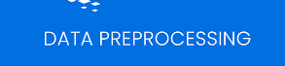
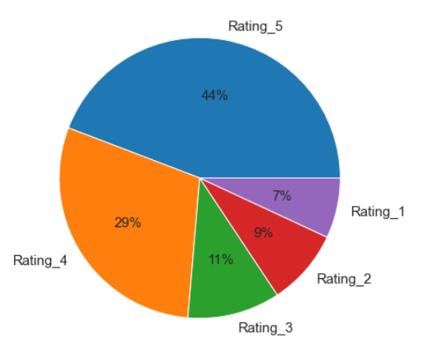
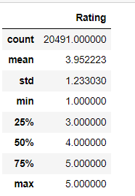
Here as we see 4 and 5 rating are contributing nearly 75% which shows biased towards positive side.

Slide 6
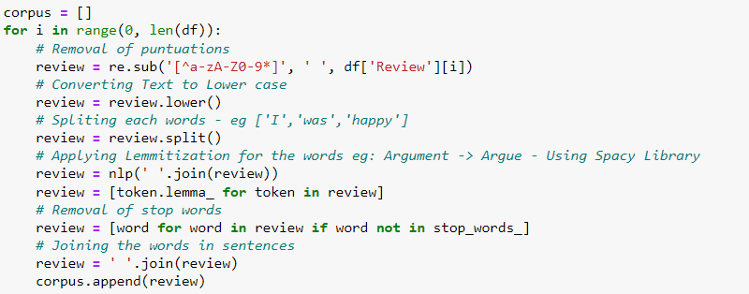
STEPS FOR DATA CLEANING
Remove Punctuation
Case change
Tokenization
Removing stop words

Slide 7
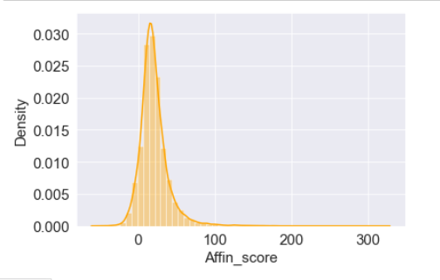
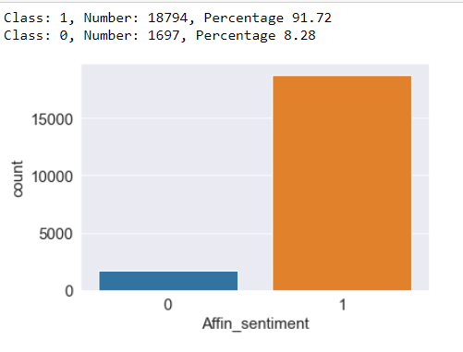
Afinn Sentiment Analysis
Afinn is the simplest yet popular lexicons used for sentiment analysis developed by Finn Årup Nielsen. It contains 3300+ words with a polarity score associated with each word. In python
From above graph we can conclude our dataset is biased towards positive side and positive sentiment percentage is 91.72 and for negative sentiment percentage is 8.28

Slide 8
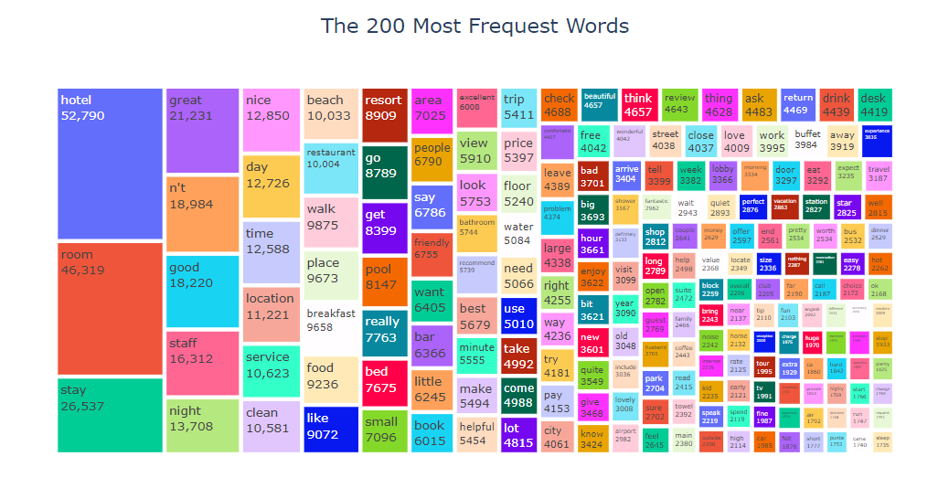
Data Visualization
Based on the Tree map above, all of the words are unique words and there are no stop words in this set. Most words are 'hotel', 'room' and 'stay'. Due to the fact that we are dealing with a hotel review dataset, it make sense.

Slide 9

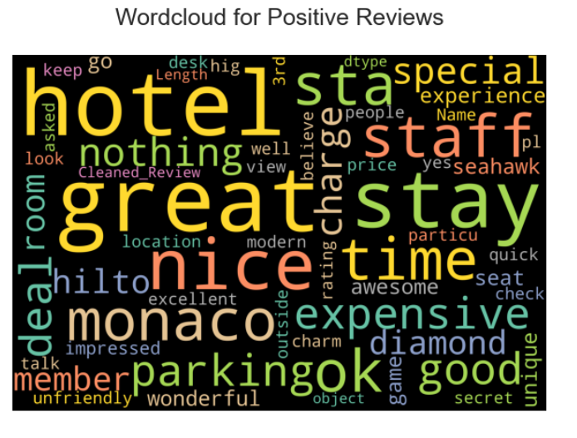
Word Cloud: Positive Reviews

Slide 10
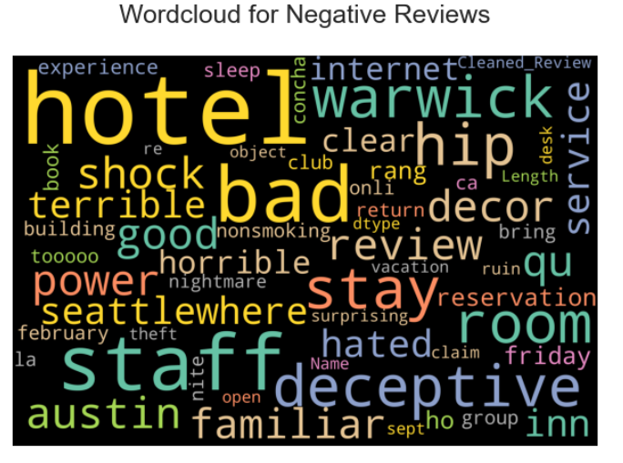
Word Cloud: Negative Reviews

Slide 11
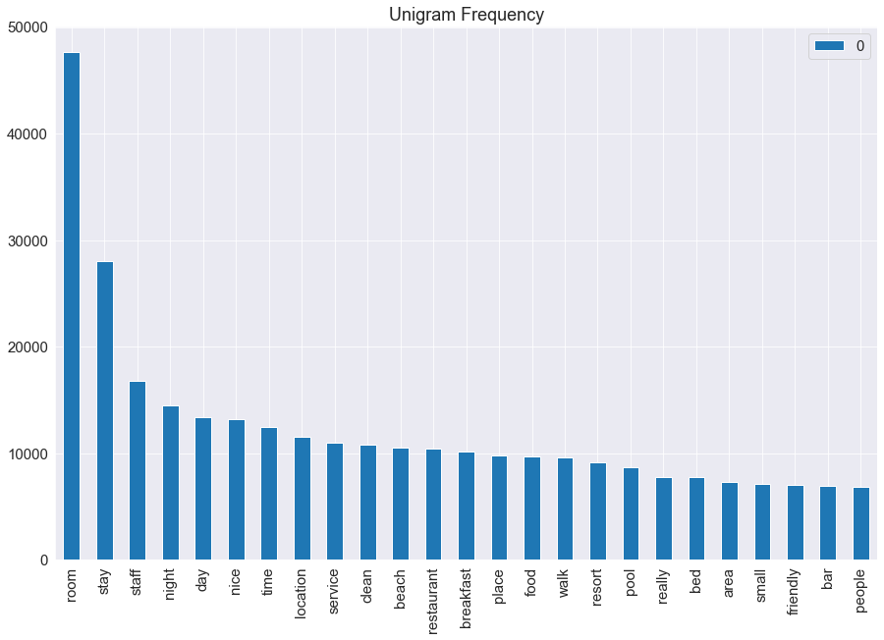
Term Frequency with Countvectorizer
CountVectorizer is breaking down a sentence or any text into words by performing preprocessing tasks like converting all words to lowercase, thus removing special characters
Unigram Frequency

Slide 12
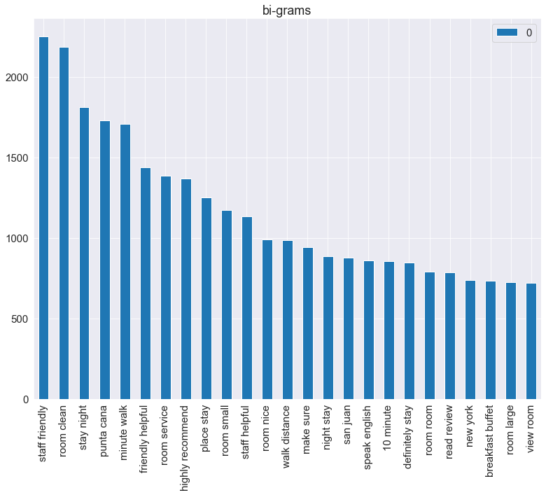
In the Bigram Language Model, we find bigrams, which are two words coming together in the corpus(the entire collection of words/sentences).
Bi-Gram

Slide 13
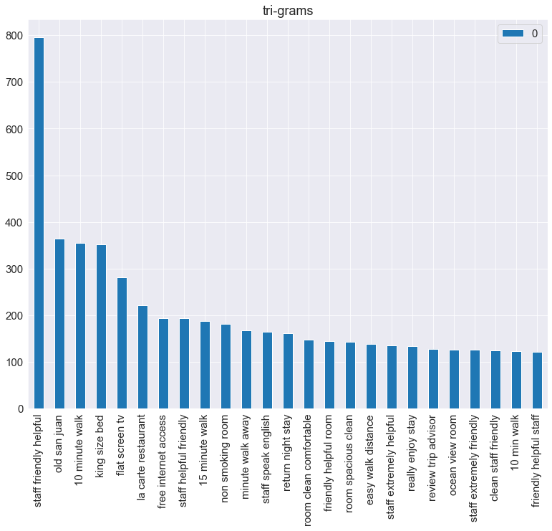
A bigram model approximates the probability of a word given all the previous words by using only the conditional probability of the preceding words while a trigram model looks two words into the past.

Slide 14
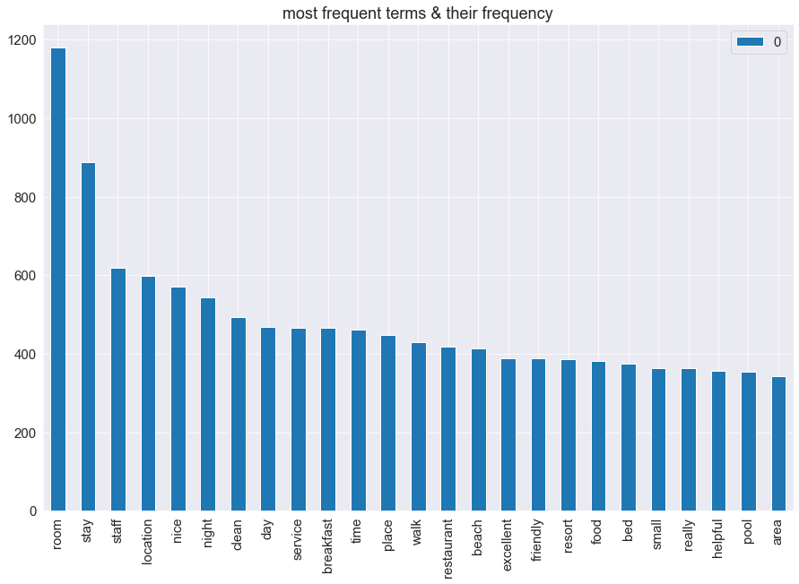
Term Frequency with TFIDF

Slide 15
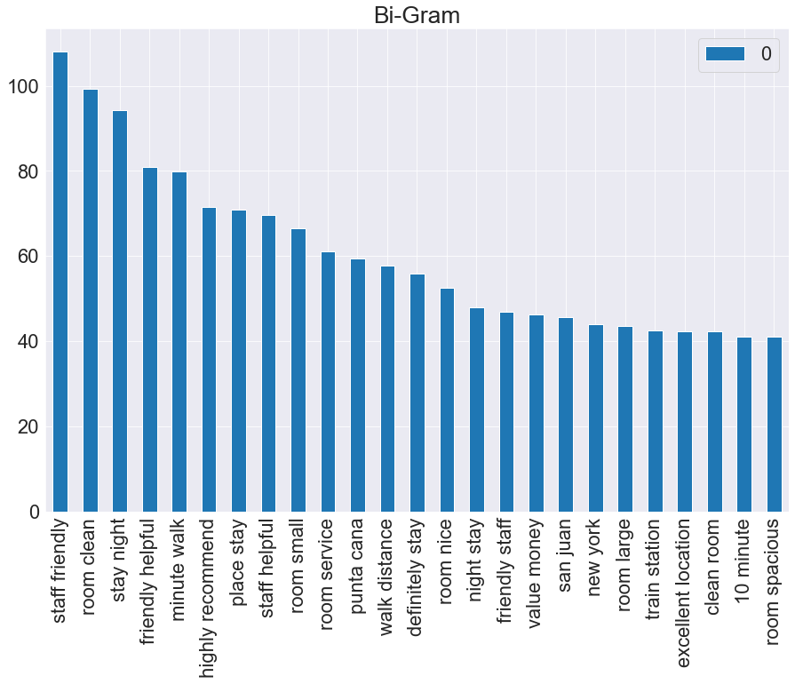
In the Bigram Language Model, we find bigrams, which are two words coming together in the corpus(the entire collection of words/sentences).

Slide 16
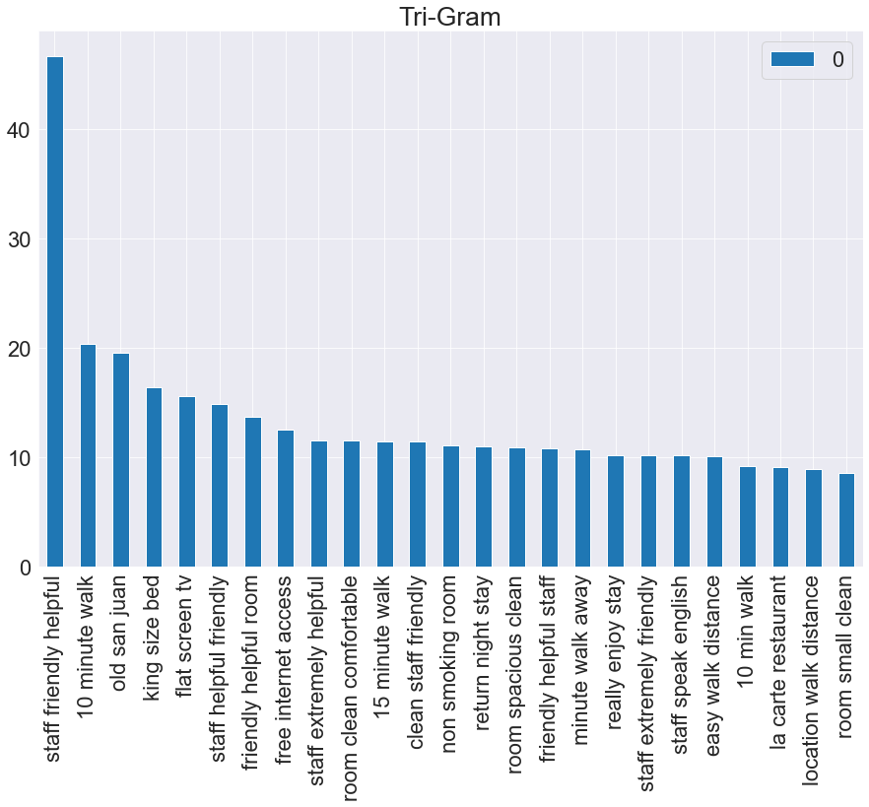
A bigram model approximates the probability of a word given all the previous words by using only the conditional probability of the preceding words while a trigram model looks two words into the past.

Slide 17
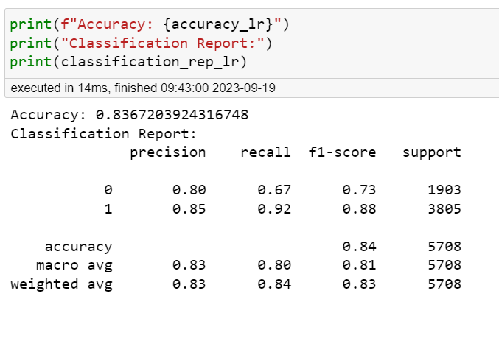
Model Building Logistic Regression
A statistical method that is used for building machine learning models where the dependent variable is dichotomous: i.e. binary. Logistic regression is used to describe data and the relationship between one dependent variable and one or more independent variables

Slide 18
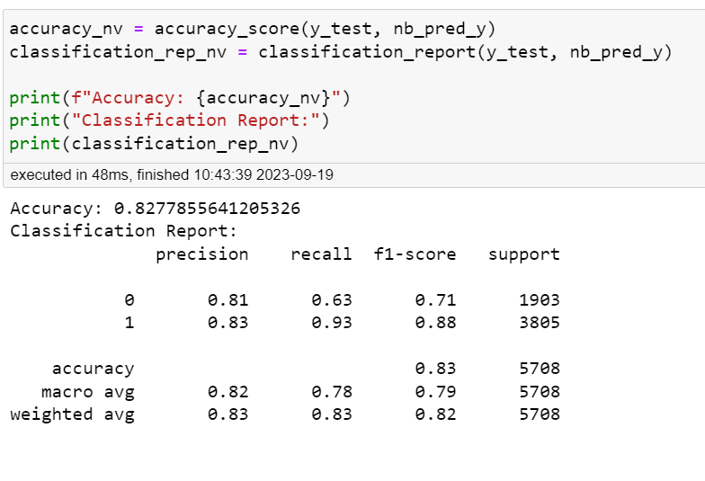
Naive Bayes
Naïve Bayes is a simple learning algorithm that utilizes Bayes rule together with a strong assumption that the attributes are conditionally independent, given the class. While this independence assumption is often violated in practice, naïve Bayes nonetheless often delivers competitive classification accuracy

Slide 19
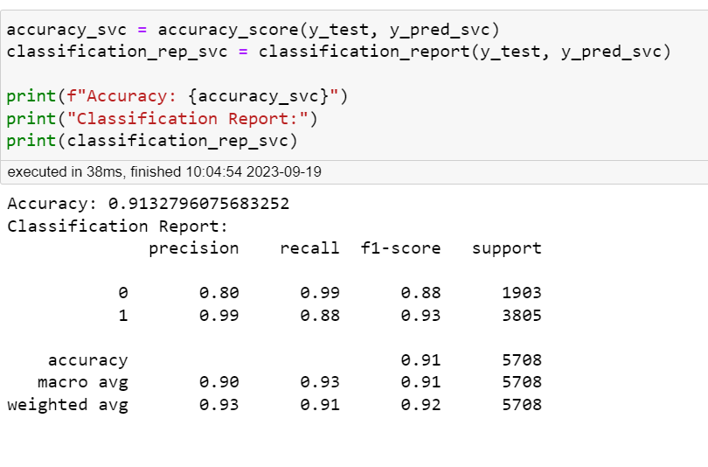
SVC
SVC stands for Support Vector Classifier, which is a type of supervised machine learning algorithm used for classification tasks. SVC is a part of the broader family of Support Vector Machines (SVMs) and is particularly effective in separating data into different classes when the data is not linearly separable in the input space.

Slide 20
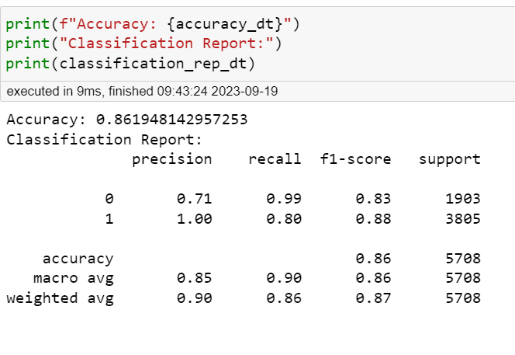
DECISION TREE
A decision tree is a popular machine learning algorithm used for both classification and regression tasks. It is a supervised learning method that is particularly useful for solving problems where you need to make decisions or predictions based on input features. Decision trees are easy to understand and visualize, making them a valuable tool for both beginners and experienced data scientists.

Slide 21
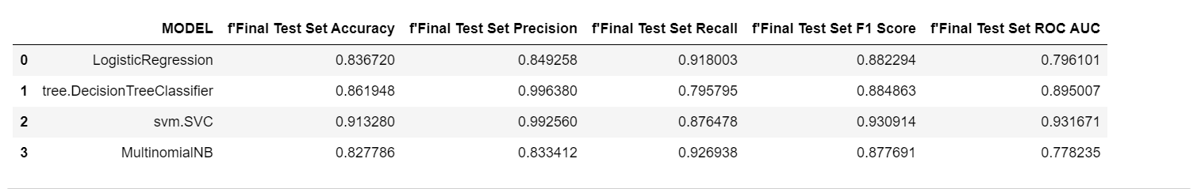

Slide 22
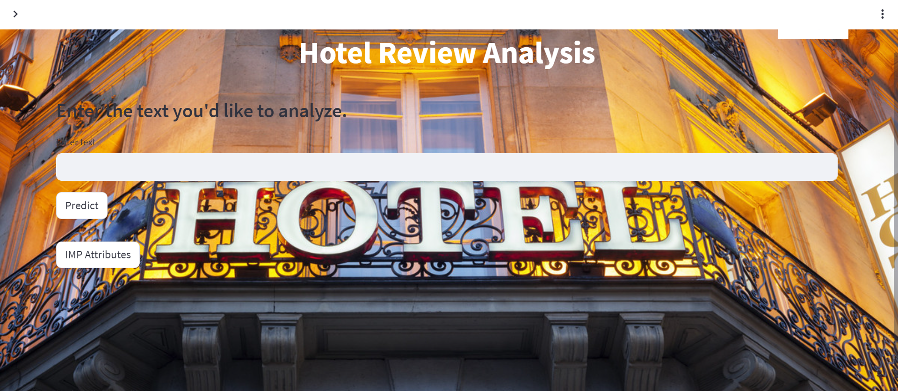
DEPLOYMENT

Slide 23
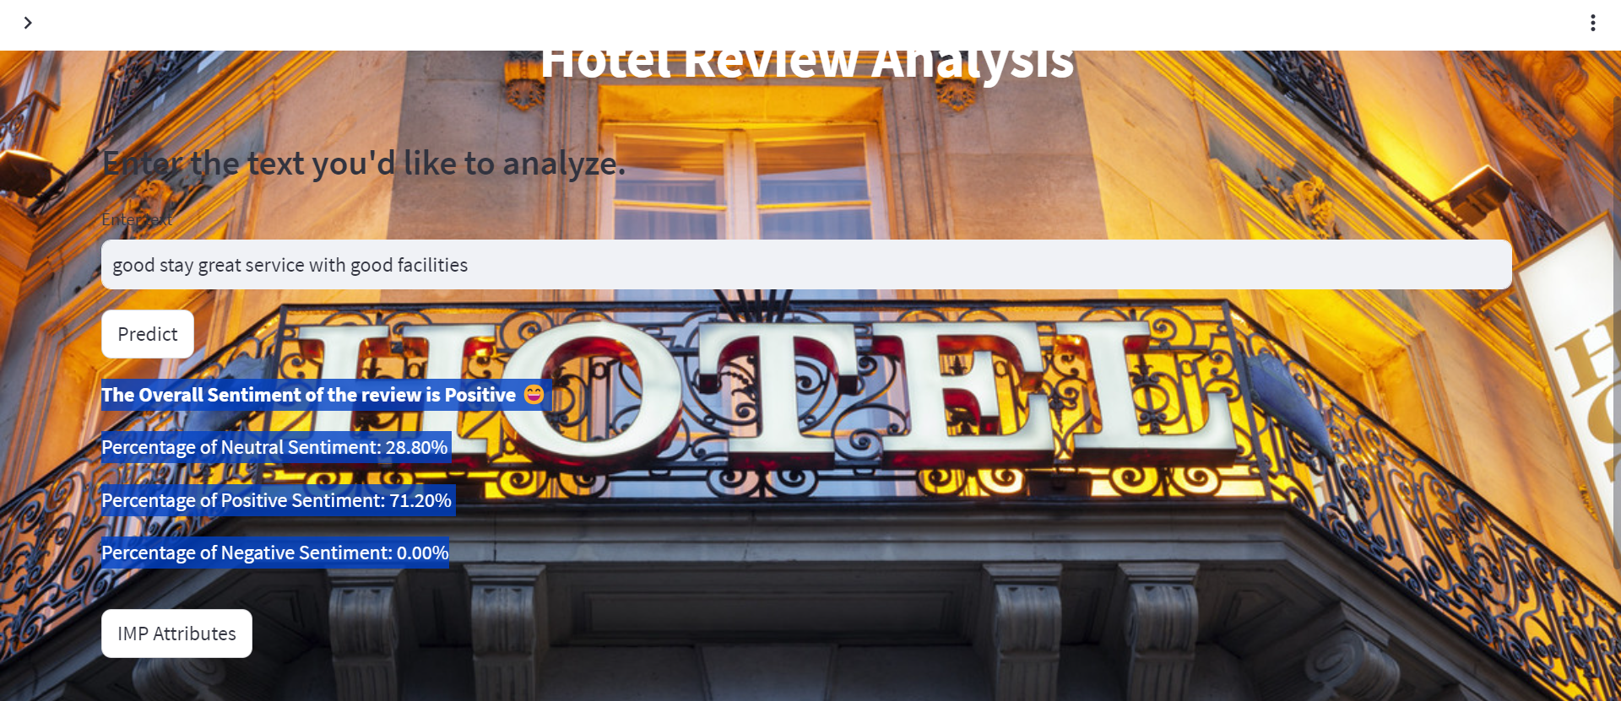
POSITIVE REVIEW

Slide 24
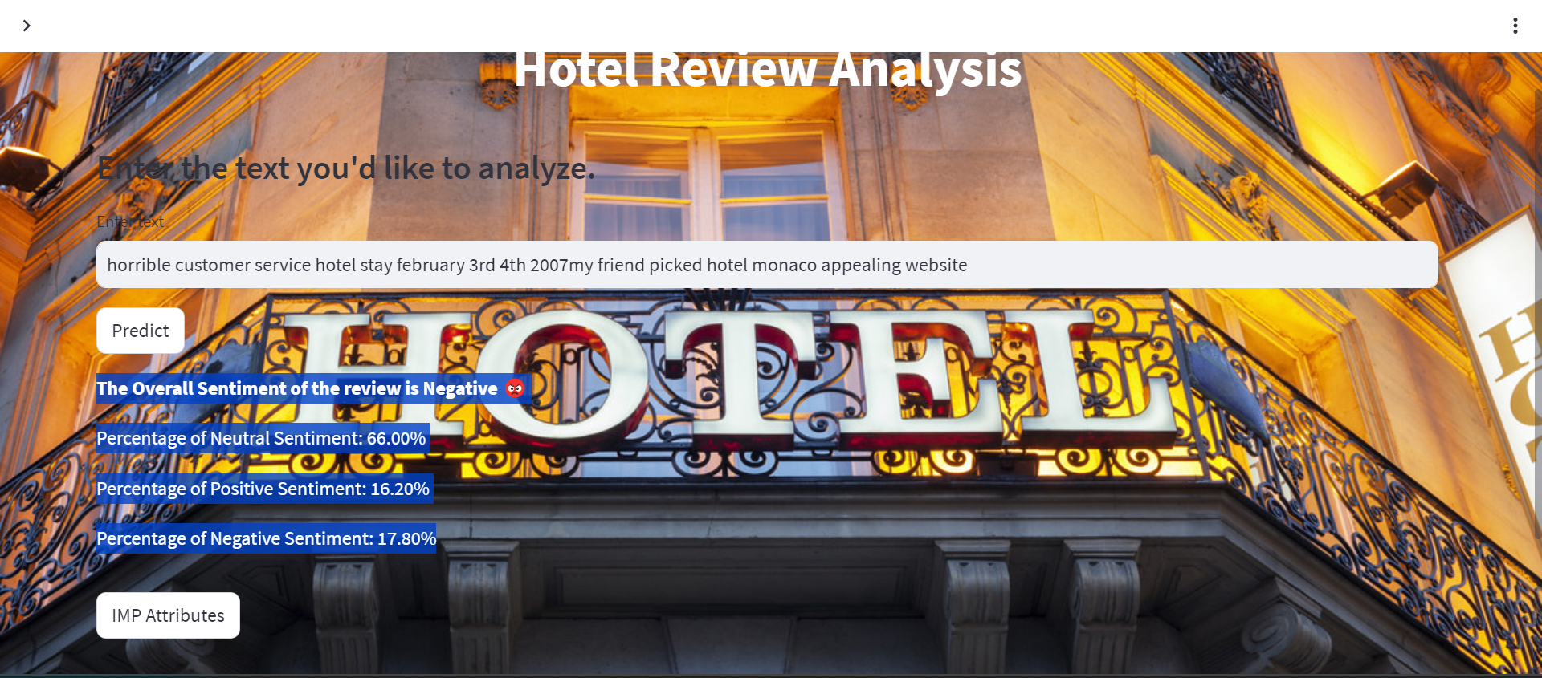
NEGATIVE REVIEW

Slide 25
Challenges faced
Considering the sentiment analysis techniques between Affin ,Vader, polarity.
Corpus building.
Model building for random forest classifier.
Deployment of code using streamlit api.

Slide 26
How we overcame
By using cross tab method we have decided to go with vader sentiment analysis.
Refered many sites and reduced errors.
randomforestclassifier model is time taking process still with overfitting issues been resolved by altering the smaple size and choosing best params.
Converting jupyter into python file helped to overcome the issue.

Slide 27
CONCLUSION
In this project, we have performed sentiment analysis on hotel reviews and have analyzed performance of Multinomial naive bayes, SVM, Logistic Regression, Decision Tree, and Random forest. It was concluded that on the basis of accuracy, SVM performs the best. It can be said that the simplicity of multinomial naive bayes does not make it less eﬀective than any other algorithm. We can observe that both SVM and multinomial naive bayes performs really well as compared to the other classification models.

Slide 28
THANK YOU

